Slide 1


Arduino Tech Forum

Slide 2
C# + ASP.NET MVC + Entity Framework + SQL Server + HTML + CSS
Technology Used

Slide 3
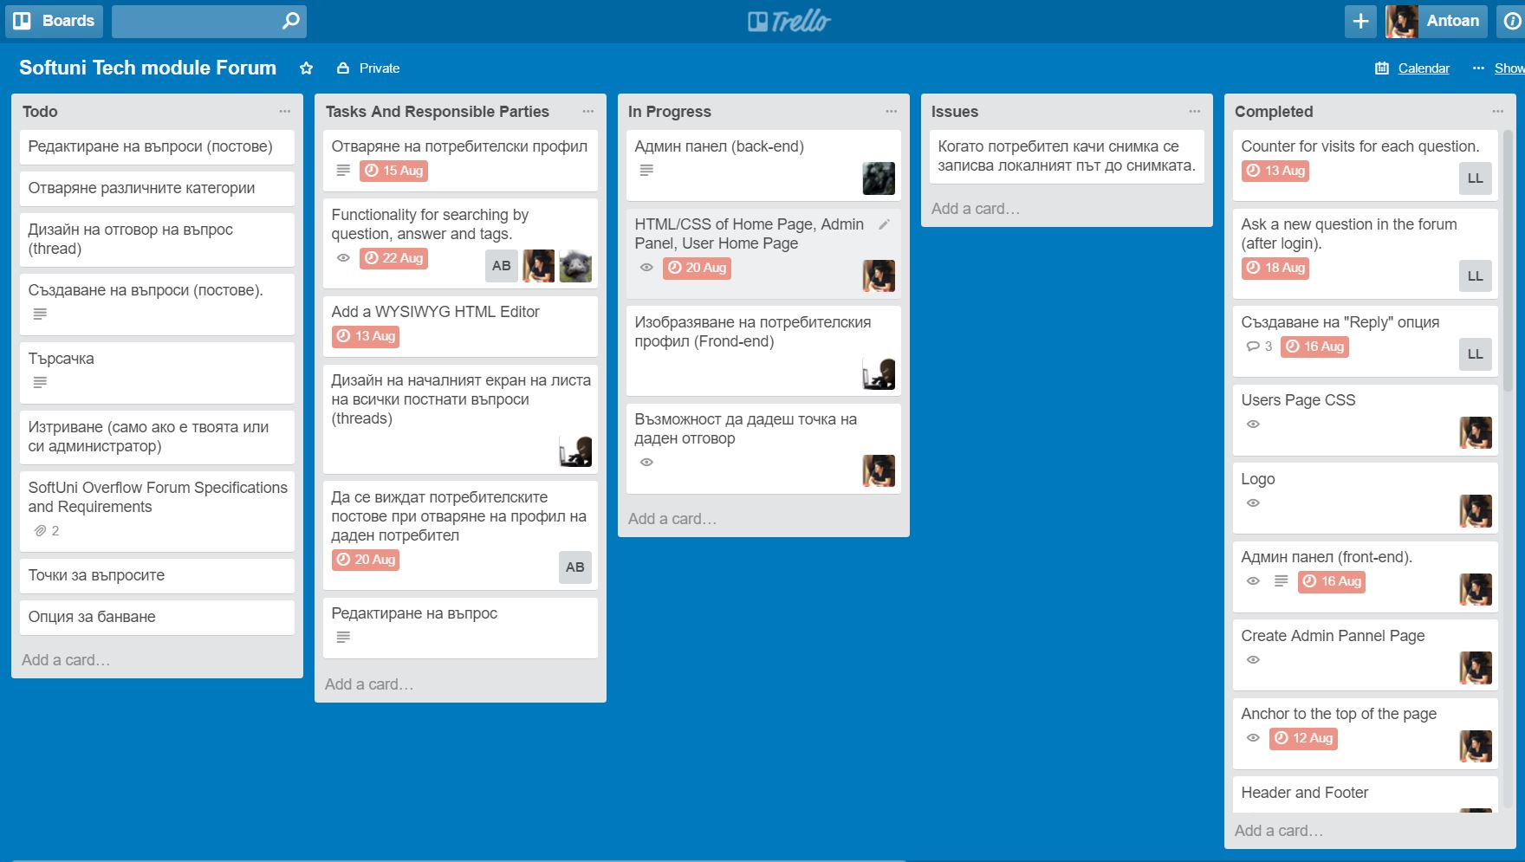
Trello

Slide 4
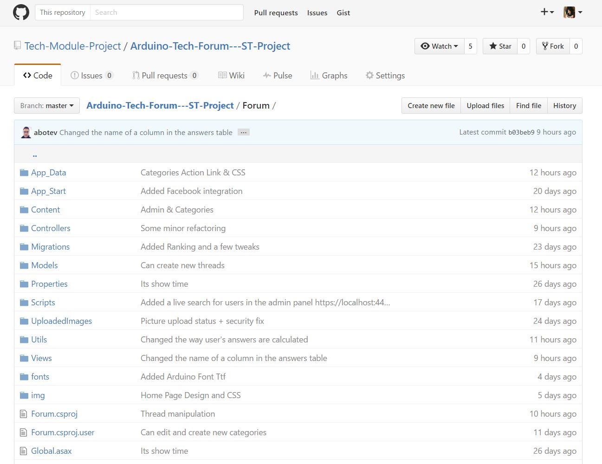
GitHub

Slide 5
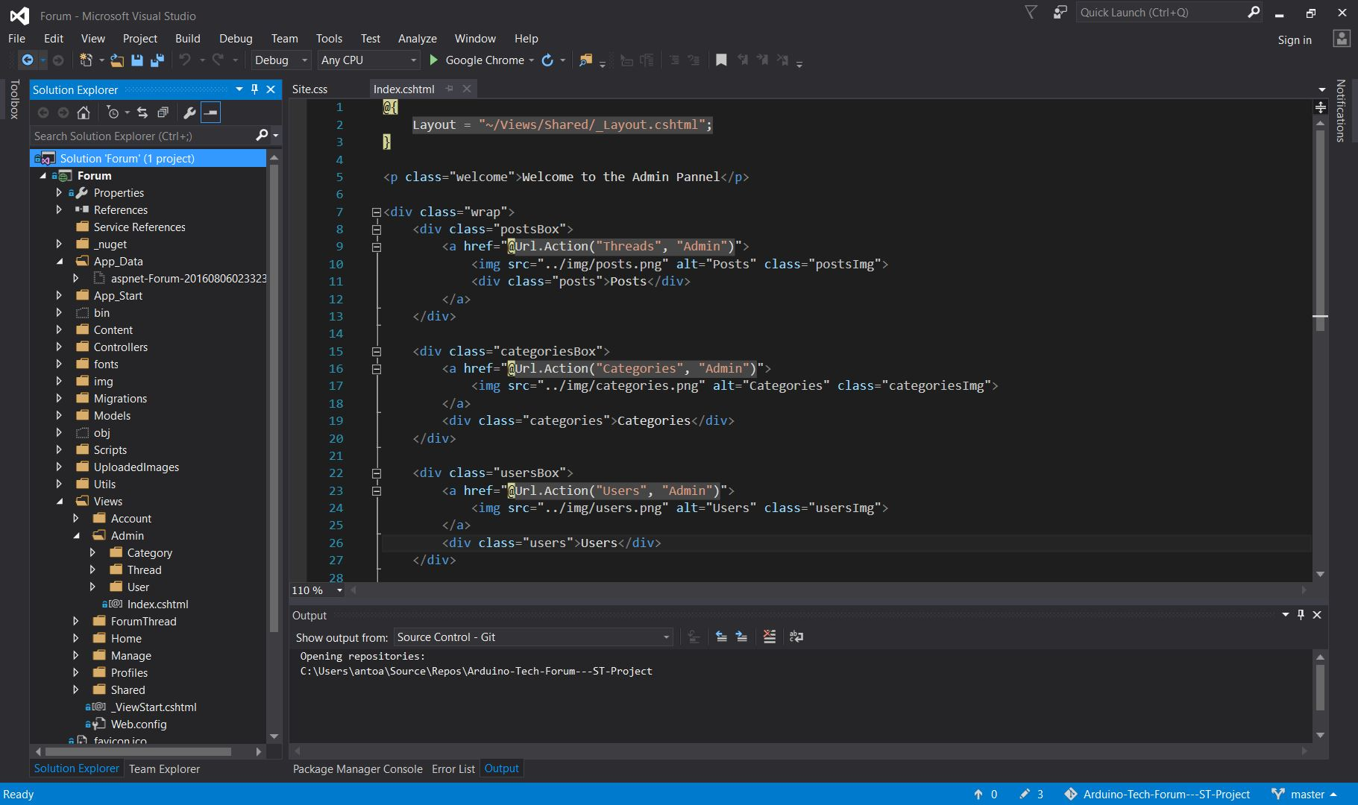
Forum

Slide 6
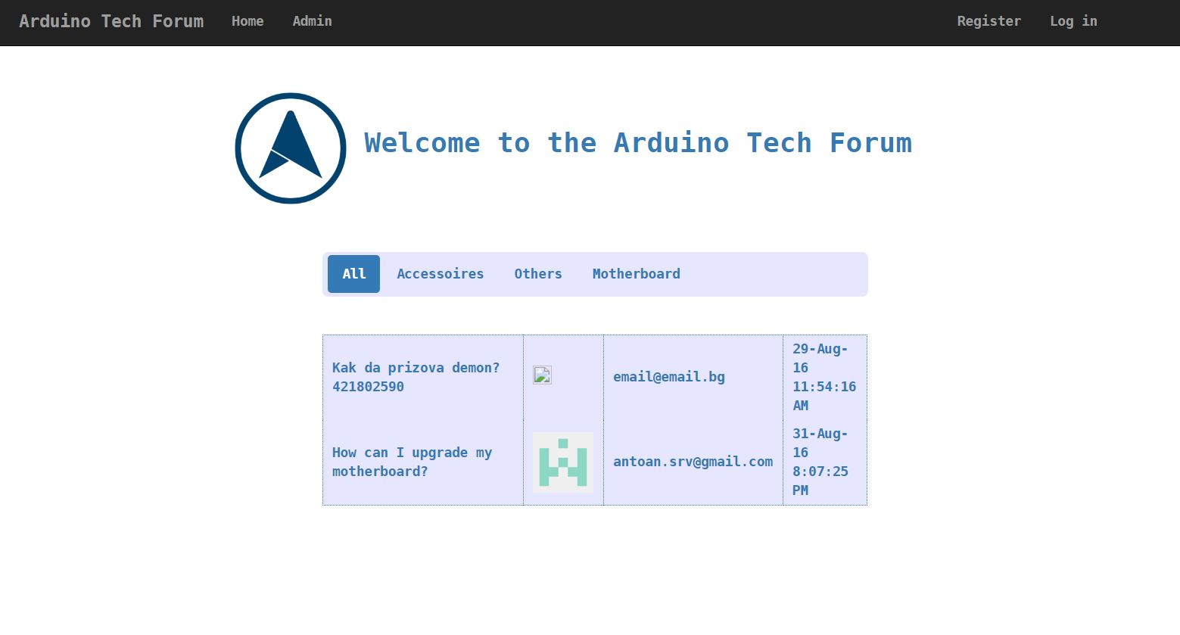
Homepage

Slide 7
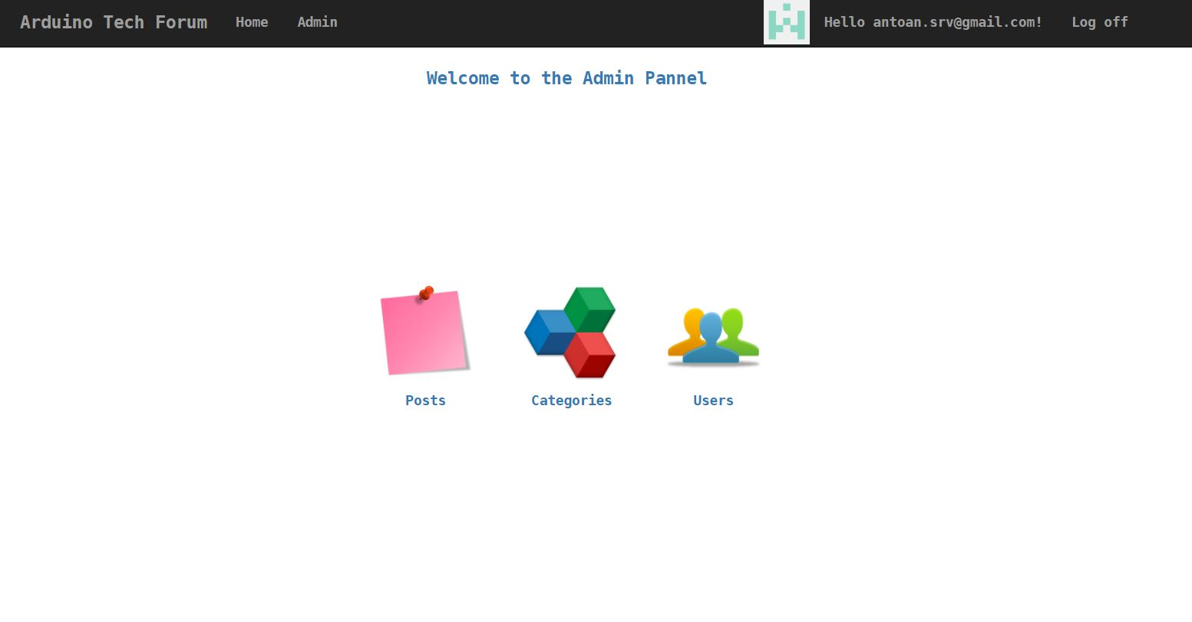
Admin Panel

Slide 8
Team Members and Responsibilities
Person | Tasks
Angelina | Graphic Design: Responsive CSS to Reply Responsive Home Page and Forum Treads and Posts
Luboslav | C# Back End: Data Base Reply to Questions Display of Categories Up vote and Down vote Automatic picture Generator
Antoan | Front End & C# Back End: Admin CSS Anchor to top of page Shared Layout CSS home page Header & Footer Users Page CSS Categories Page CSS Logo Project Planning
Angel | C# Back End: User Treads and Answers Fixes
Denis | C# Back End: Admin Panel Captcha Creating New Posts Log In With Facebook

Slide 9
Thank You!

